Slide 1


Project Title :
Develop AI and ML frameworks/models to automate the university application process

Slide 2
Group 5
Tanmay Daulatwal – 798588
NIREN PATEL – 794177
Shashank Tripathi – 789803
Nitin Singh Rana - 770080
GitHub Link : -https://github.com/EdmissionCapstone/Capstone-Edmission

Slide 3
Content
Problem Statement
Research Questions / Objectives
Dataset Information
Preprocessing data
Next Steps
References
Analytical Goals

Slide 4
Problem Statement
Universities are increasingly struggling to handle the admission process effectively due to the advancement of technology and rise in student enrolment.
A bad admissions procedure may lead to fewer students getting admitted into an university because of errors or excessively long response periods.
The traditional admission process requires a lot of manual effort and it is time consuming.

Slide 5
Problem Statement
This is where machine learning (ML) and artificial intelligence (AI) may be used to automate the admissions process and make it more effective.
To create an AI and ML-based system that can automate the university application process, including challenges like gathering and processing applicant information, producing individualized recommendations for colleges and programs, and managing communication with applicants and universities.

Slide 6
Research Questions
What technologies and software can be used to identity where the student appearing for the interview is genuine or not ?
What are the key requirements which will help the ML model to predict the acceptance rate of a student in any university ?
Is IELTS/GRE/TOFEL score a major concern before applying for any university, how can the ML model help us in making a decision ?
How can be data scraping be achieved in extracting universities data to train the model ?

Slide 7
Dataset Information
The information collected is believed to be highly accurate, complete, and comprehensive as it was sourced directly from the institutions' official websites
The data collected for Ten universities and colleges contains information required for university application process. (ID, Program Level, Program Name, School Name, Location, Tuition Fees, Application Fees, University Page).
The data also contains the application URL, which makes it simple to acquire additional specific information about each program

Slide 8
Dataset Pre-processing
Post manual collection of data, it was cleaned in excel and selected columns will be used to train the ML models for project.

Slide 9
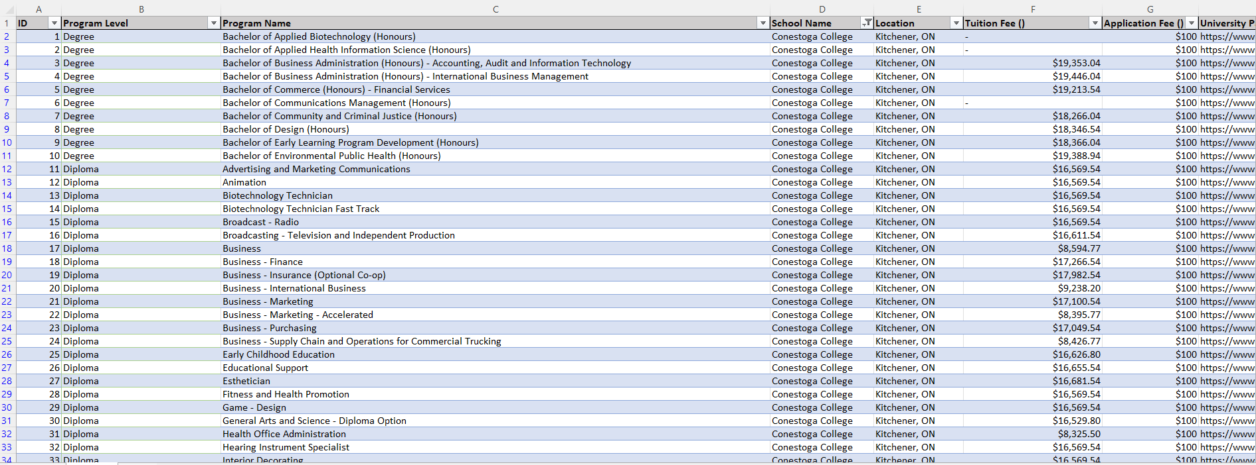
Data Sample

Slide 10
Analytical Method
Demographic Analysis: This involves analyzing data on student demographics, such as age, gender, location, and educational background. Demographic analysis can be used to identify target student populations and to tailor recruitment strategies to their specific needs and preferences
Application and Enrollment Data Analysis: This involves analyzing data on student applications and enrollment, including application completion rates, enrollment rates, and student retention rates. Application and enrollment data analysis can be used to identify areas for improvement in the recruitment process and to measure the effectiveness of recruitment strategies.
Clustering Algorithms: These algorithms can be used for market segmentation to identify groups of students with similar characteristics and needs. Examples of clustering algorithms include k-means clustering and hierarchical clustering.
Classification Algorithms: These algorithms can be used for student segmentation to classify students based on their interests, preferences, and academic background. Examples of classification algorithms include logistic regression, decision trees, and random forests.
Classification and clustering algorithms can be useful methods for a student recruitment agency project. Classification algorithms can be used to predict the likelihood of a student enrolling in a particular program based on their characteristics, while clustering algorithms can group students into clusters based on similarities in their characteristics.So,it will be suitable for this project

Slide 11
Next Step
The Next step is to find the best machine learning model for the project and use it the data that we scarped from college websites.
We need to find best model which gives us best results for facial recognition using python with authentication.And we have to develop code for voice to speech conversion and in specfic format like csv or text file.
we need to figure out how the database will be created with tables and how tables will relate to each other and create stored procedures to communicate with the code and machine learning model.

Slide 12
References
Reference’s: https://aisel.aisnet.org/cgi/viewcontent.cgi?article=1011&context=iceb2018
https://ieeexplore.ieee.org/document/9994112
https://www.sciencedirect.com/science/article/abs/pii/S1053482222000079
https://www.analyticsvidhya.com/blog/2021/07/face-key-point-recognition-using-cnn/
https://keras.io/guides/keras_cv/custom_image_augmentations/

Slide 13
THANK YOU

